Slide 1
Course - DT228/1
Information Technology Fundamentals
INFORMATION TECHNOLOGY (IT) COMPONENTS

Slide 2
Information Technology
Information technology (IT) is “the technology involving the development, maintenance, and use of computer systems, software, and networks for the processing and distribution of data.”
www. merriam-webster.com
IT includes the set of tools, processes, methodologies such as programming, communications, data conversion and storage – with the hardware and software of computer systems.

Slide 3
Computer System Parts
Computer systems are composed of hardware, software, and firmware.
Hardware is something you can touch and feel; the physical computer itself.
Software - there are two types: system software and applications software. Software is made up of instructions and makes the hardware work.
Firmware is a software program or set of instructions programmed on a hardware device permanently and stored on ‘Read Only Memory’.

Slide 4
Computer System Parts (2)
The operating system is collection of system software programs that coordinates the interaction between hardware and software applications, and the interaction between a user and the computer.
Operating system examples include: DOS (Disk Operating System), Windows 7, Windows 8, Windows 10, OS X, Unix and Linux. (Ubuntu – based on Linux)

Slide 5
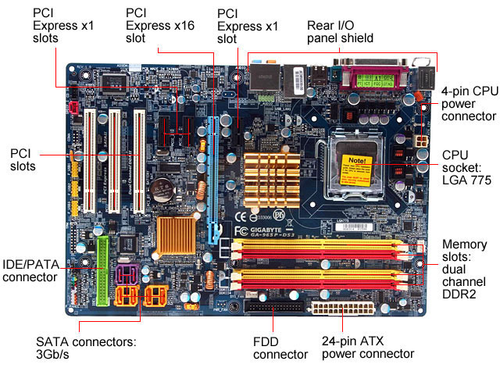
Hardware - Motherboard
Personal Computer motherboard example (View from above)

Slide 6
Hardware - Motherboard (2)
The motherboard is the main circuit board that contains most of the electronics and is the largest electronic circuit board in the computer. All computer components connect to, or communicate through, the motherboard.
Central to operations is the Central Processing Unit.

Slide 7
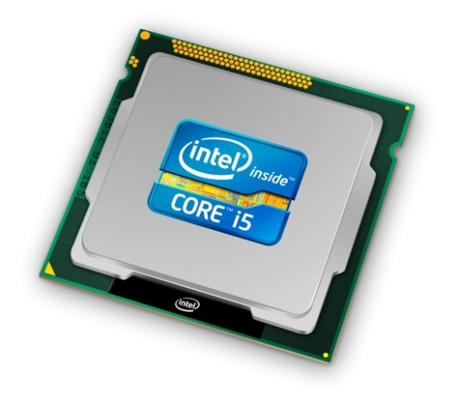
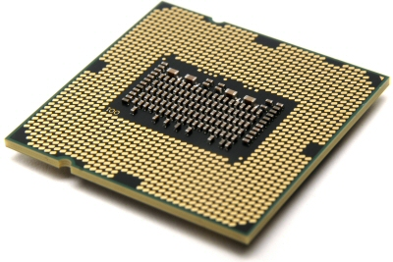
Hardware – Central Processing Unit
This is a PC (Personal Computer example):
Intel i5 CPU container, as seen from above, and a view from the underside.
This is plugged into the CPU socket placement of the motherboard.

Slide 8
Hardware - CPU
The CPU is often referred to as the “brain” of the computer.
It is responsible for controlling all activities of the computer system.
The three major components of the CPU are:
1. Arithmetic Unit (Computations performed)
Accumulator (Results of computations kept here)
2. Control Unit (Has two locations where numbers are kept)
Instruction Register (Instruction placed here for analysis)
Program Counter (Which instruction will be performed next?)
3. Instruction Decoding Unit (Decodes the instruction)

Slide 9
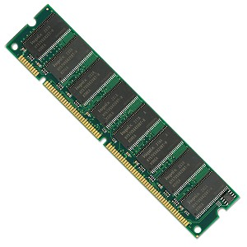
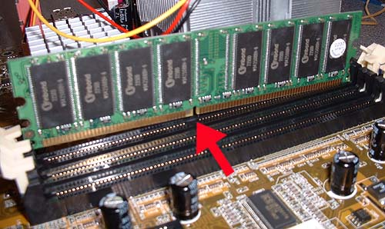
Hardware – Random Access Memory
Random Access Memory (RAM) often appears as 8 or 16 chips on a card. These have slot connectors for SIMM and DIMM (Single and Dual Inline Memory Modules).

Slide 10
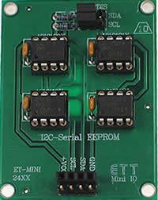
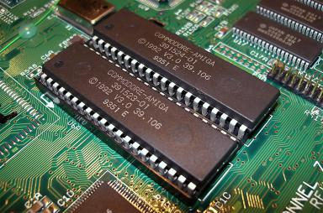
Hardware – Read Only Memory
Read Only Memory (ROM) often appears as chips directly on the motherboard. This second example is EEPROM (Electrically Erasable and Programmable Read Only Memory) combined on an integrated circuit.

Slide 11
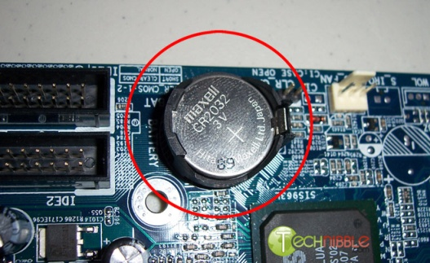
Hardware – RAM and ROM
RAM (Random Access Memory) is volatile memory (i.e it loses data inside the chips when power is shut off) that holds applications instructions and data while the computer is operating.
ROM (Read-Only Memory) is non-volatile memory (it retains data (such as firmware) when power is shut off by having battery power).

Slide 12
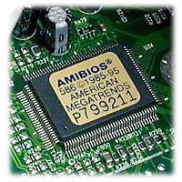
Hardware – RAM and ROM (2)
ROM BIOS (Read Only memory Basic Input / Output System) is an important chip on the motherboard that holds the start-up software for the computer to operate. It also holds software instructions for communication of the input/output devices and other hardware devices important to startup procedures.

Slide 13
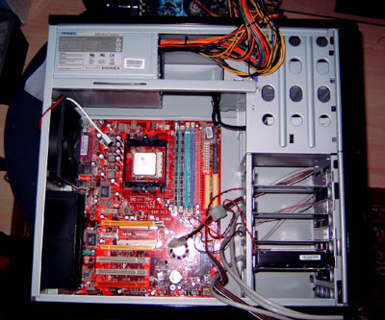
Hardware – Motherboard in a Tower

Slide 14
Hardware – Hard Drive
The hard drive, or hard disk is often abbreviated to HD or HDD, is a common storage device for maintaining files inside the computer.
The hard drive is the main storage media device on PCs and laptops that stores all data on the computer more permanently and in much greater volume than RAM.

Slide 15
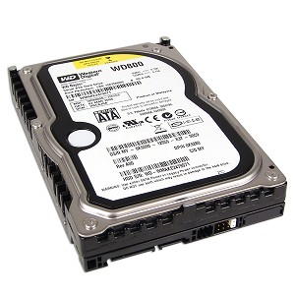
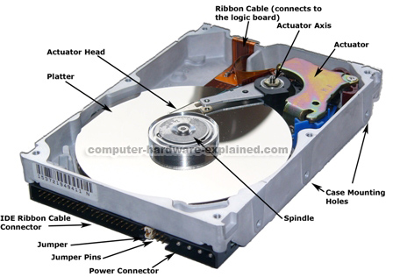
Hardware – Hard Drive (2)
PC hard disk example – complete and showing internal components

Slide 16
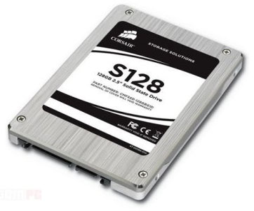
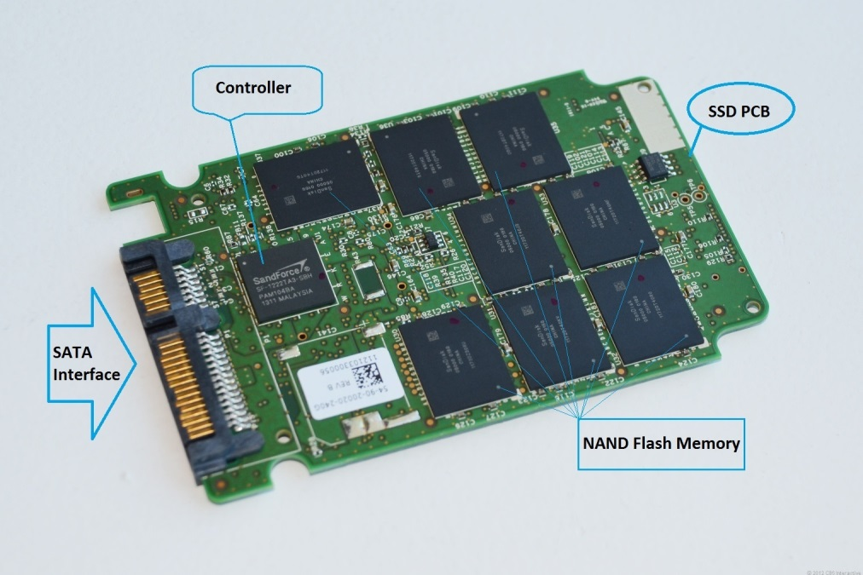
Hardware – Solid State Hard Drive
PC solid state drive (SDD) example – complete and showing internal components

Slide 17
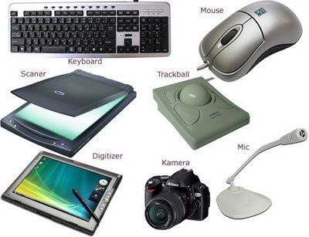
Hardware – Input Devices
PC input device examples

Slide 18
Hardware – Input Devices (2)
Input hardware examples that deal with original data (directly input data):
Keyboard
Mouse
Voice recognition hardware
Scanner
Digital camera

Slide 19
Hardware – Input Devices (3)
The purpose of input devices is to allow the user to enter data into a computer system, or to issue instructions (commands) to a computer.
The input device transforms data from the user into a form that a computer system can process by using software called device drivers.

Slide 20
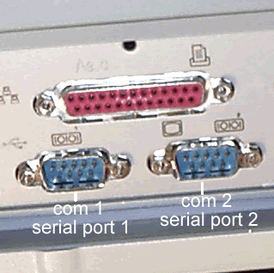
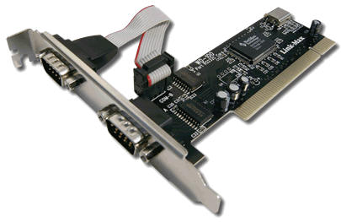
Input Device Connection
The traditional input device connection has been the serial connector.

Slide 21
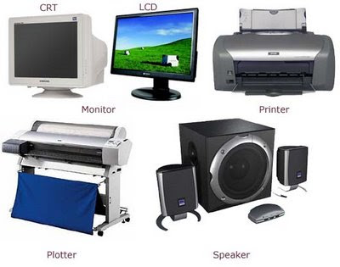
Hardware – Output Devices
PC output device examples

Slide 22
Hardware – Output Devices (2)
Output devices convert information coming from a computer system into some form perceptible by humans. Output hardware examples include:
Visual (monitor, printer)
Auditory (speakers (non-speech, speech))
Tactile
Tactile output for visually-impaired and blind users (e.g. Braille)

Slide 23
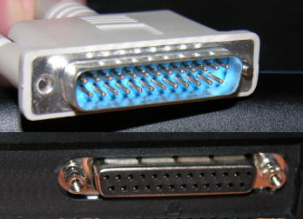
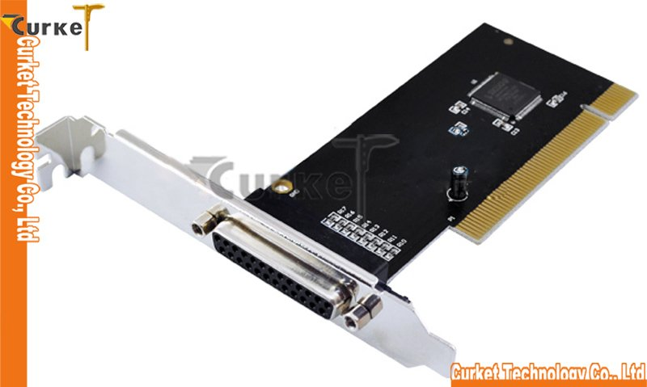
Output Device Connection
The traditional output device connection has been the parallel connector.

Slide 24
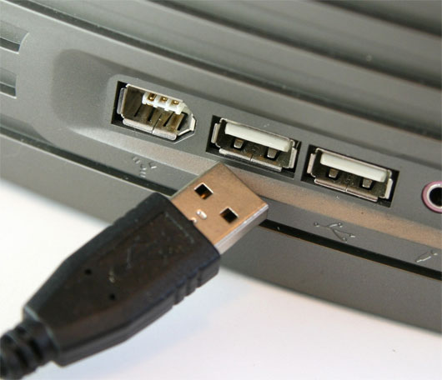
USB Connection
For input and output devices, since the late 1990s, USB (Universal Serial Bus) connectors have replaced serial and parallel connectors for many input and output devices.
It is not an I/O device itself, but it hosts input and output connections to the motherboard.
USB connector and hub

Slide 25
Popularity of Universal Serial Bus
One interface for many devices. USB is usable with many kinds of peripheral devices. Instead of having a different connector type and supporting hardware for each peripheral, one interface serves many.
Automatic configuration. When a user connects a USB peripheral to a computer, its operating system (OS) automatically detects the peripheral and loads the appropriate software driver.
…/ continued

Slide 26
Popularity of Universal Serial Bus (2)
Hot pluggable You can connect and disconnect a peripheral whenever you want, whether or not the system and peripheral are powered, without damaging the PC or peripheral. The OS detects when a device is attached and readies it for use.
No power supply required (sometimes). A peripheral that requires up to 500 milliamperes can draw all of its power from the bus instead of having its own supply.

Slide 27
USB 1, 2, 3
Three generations of USB:
USB 1.0
USB 2.0
USB 3.0 and WUSB
USB 1.0 specification introduced in 1994
USB 2.0 specification finalised in 2001
2.0 became popular due to a cost/benefit advantage
Eg. IEEE 1394 – high bandwidth, high cost

Slide 28
USB 2.0
The USB’s evolution to version 2.0 meant support for much faster data transfers. A 40-times increase was now feasible, for a bus speed of 480 Megabits per second.
USB 2.0 is backwards compatible with USB 1.1. Version 2.0 peripherals can use the same connectors and cables as 1.x peripherals.
To use the new, higher speed, peripherals must connect to 2.0-compliant hosts and hubs. 2.0 hosts and hubs can also communicate with 1.x peripherals.
A 2.0-compliant hub with a slower peripheral attached will translate as needed between the peripheral’s speed and high speed.
This increases the hub’s complexity but makes good use of the bus time without requiring different hubs for different speeds.

Slide 29
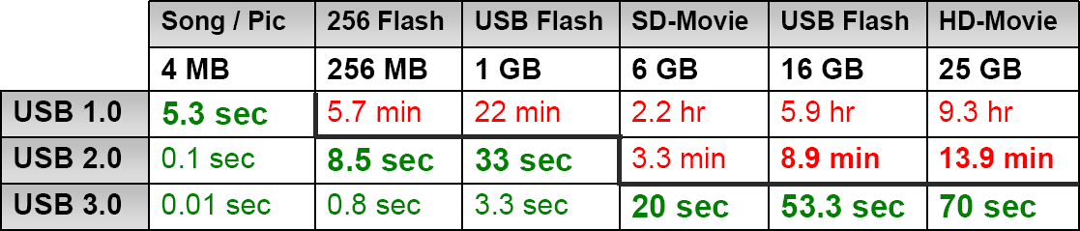
USB 3.0
3.0 is also referred to as ‘SuperSpeed USB’.
Backward compatible with USB 2.0.
Speeds are ten times faster than 2.0 (5 Gbps in a controlled test environment).
Transfer of 25 GB file in approx 70 seconds (see chart)

Slide 30
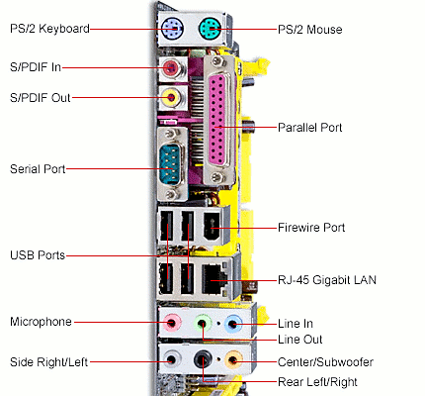
PC I/O Connectors Roundup

Slide 31
Other Internal Hardware Devices
Other internal components of the personal computer include:
Power supply - Converts AC voltage from the wall outlet to DC voltage the computer can use, supplies DC voltages for internal computer components and has a fan to keep the computer cool.
DVD (Digital Versatile Disk) drive - Popular alternative to a CD drive that supports CDs as well as music and video DVDs.

Slide 32
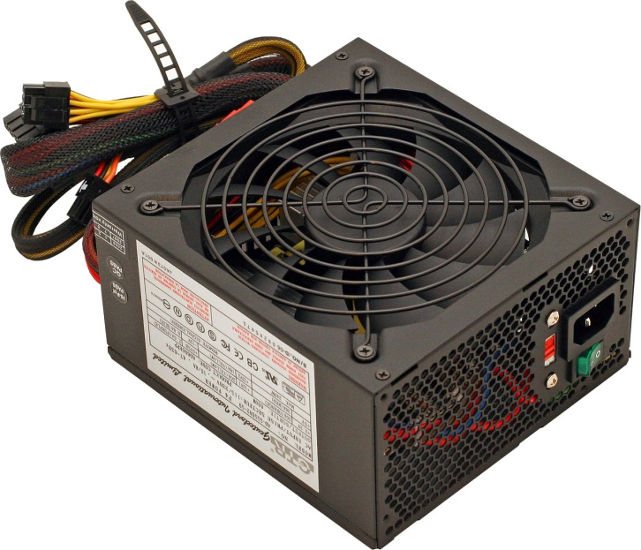
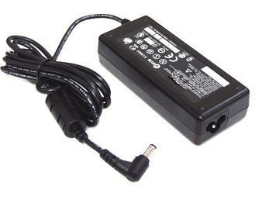
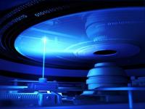
Other Internal Hardware Devices (2)
PC Power Supply
Laptop Power Supply
DVD Drive

Slide 33
Software
There are two main types of software for all computers – not just PCs:
Systems software
I include operating systems in systems software
Applications software

Slide 34
Systems Software
Systems software coordinates the activities and functions of hardware and programs.
This software is designed to run a computer’s hardware and application programs. In the layered model of a computer system this software is the interface between the hardware and user applications.
APPLICATION SOFTWARE
SYSTEM SOFTWARE
HARDWARE

Slide 35
Systems Software (2)
As well as controlling the operations of computer hardware, systems software supports application programs’ problem-solving capabilities.
Types of systems software:
Operating systems
Utility programs
Middleware

Slide 36
Operating Systems
The Operating system (OS) is a set of programs that controls the computer hardware and acts as an interface with application programs.
Operating system goals:
Execute user programs and make solving user problems easier
Make the computer system convenient to use
Use the computer hardware in an efficient manner

Slide 37
Operating Systems (2)
The OS ‘Kernel’ is an instruction management feature program that ties all components of the OS together and regulates other programs.
The kernel is the one program running at all times on the computer.

Slide 38
‘Startup’ Instructions
A bootstrap program is loaded at power-up or reboot of a PC. Know as ‘booting’ or ‘bootup’.
The booting program is typically stored in ROM or EPROM, generally known as firmware.
These instructions initialise all aspects of system.
The startup sequence loads the operating system kernel and starts execution of further programs.

Slide 39
Back to the Operating System
There are various combinations of OSs, computers, and users:
Single computer with a single user
Single computer with multiple users
Multiple computers
Special-purpose computers

Slide 40
Operating Systems (4)
Activities performed by the operating system:
Perform common computer hardware functions
Provide a user interface and input/output management
Provide a degree of hardware independence
Manage system memory
Manage processing tasks
Provide networking capability
Control access to system resources
Manage files

Slide 41
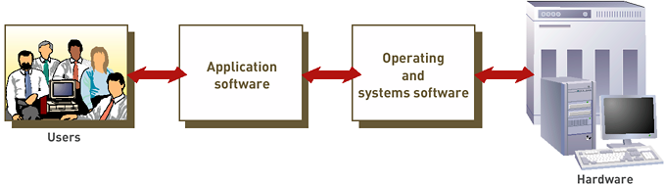
Systems Software Recap
The role of Systems Software – to interface between users, application software and hardware

Slide 42
Utility Programs
Another example of systems software – utility programs.
Utility programs help to perform maintenance, such as correcting problems with a computer system.
Common types of utility programs:
Hardware utilities
Virus-detection and recovery utilities
File-compression utilities
Spam and pop-up blocker utilities

Slide 43
Utility Programs (2)
More utilities software examples:
Network and Internet utilities
Server and mainframe utilities
Other general utilities might be used for:
Managing and protecting corporate documents
Helping people with visual disabilities use the Internet
Monitoring employees
Searching for files and documents

Slide 44
Middleware
Middleware is software that allows different systems to communicate and exchange data.
Middleware can also be used as an interface between the Internet and older legacy systems.

Slide 45
Applications Software
The primary function of application software is to allow individuals, workgroups, and the entire organisation (such as a business) the ability to solve problems and perform specific tasks.
Application programs interact with systems software; systems software then directs computer hardware to perform the necessary tasks.

Slide 46
Applications Software (2)
‘Applications’ serve the needs of an individual user.
Applications software programs include personal productivity software, enabling users to improve their personal effectiveness.

Slide 47
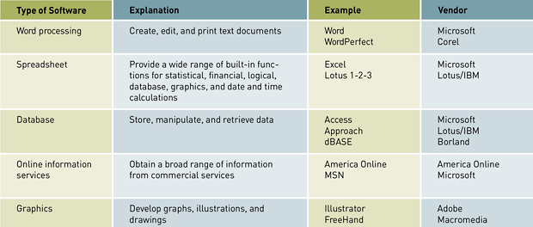
Applications Software (3)

Slide 48
Applications Software (4)
Software suite: collection of single application programs packaged in a bundle
Microsoft Office: most popular general-purpose software suite
Other general-purpose software suites: Corel’s WordPerfect Office, Lotus SmartSuite, Sun Microsystems’s StarOffice (now Oracle Open Office)
Integrated application packages offer a range of capabilities for less money than software suites
Example: Microsoft Works (up to 2008)

Slide 49
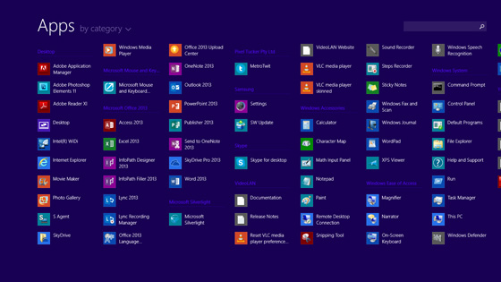
Windows 8 Application Examples

Slide 50
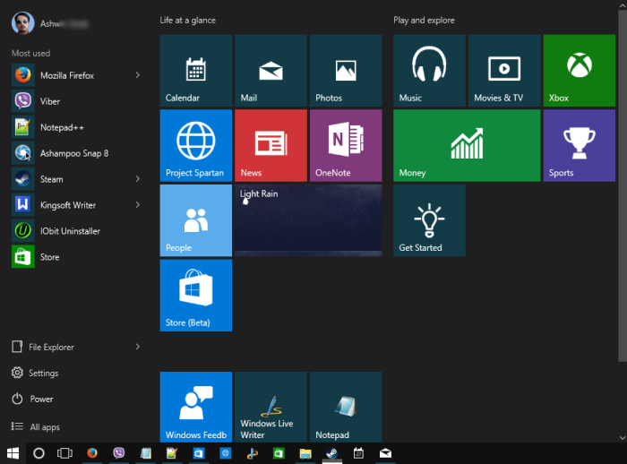
Windows 10 Application Examples

Slide 51
Applications Software (5)
Applications software should be designed to be:
User-friendly
Easy to manage
Intuitive
Minimum training and documentation needed to use it

Slide 52
Application software
Proprietary software
Off-the-shelf software
In-house developed
Contract
Customized package
Standard package
In-house customized
Contract customization

Slide 53
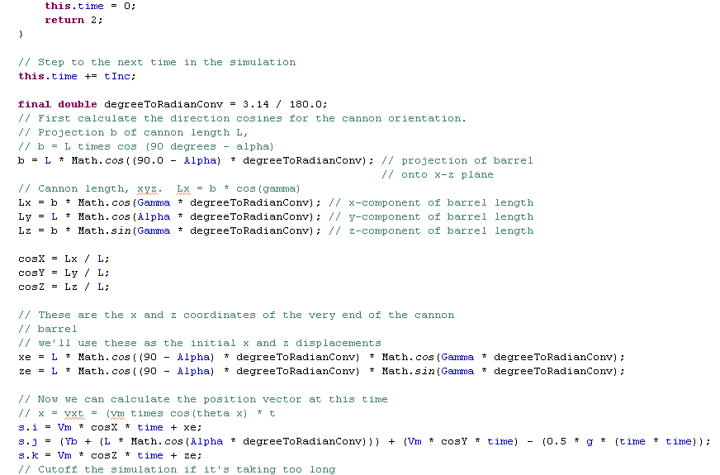
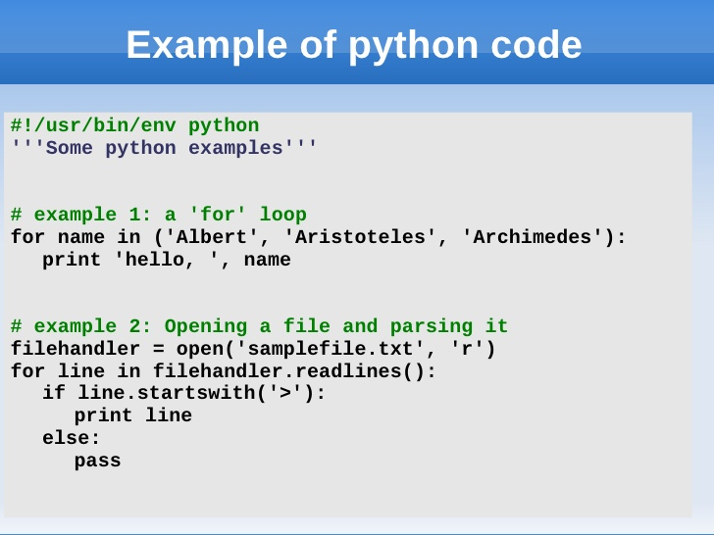
Applications Software Code
Example of Java code

Slide 54
Applications Software Summary
Applications software:
Applies to ‘real-world tasks’
Solves ‘users’ problems’
Operating Systems and systems software, generally – in comparison:
Controls hardware

Slide 55
Up Next
Next week’s lecture title is:
History of Information Technology

